Slide 1
Angular 8 - Day 2
Basic Concepts, Binding

Slide 2
Vignesh Murali Natarajan (119780) Edited By Jason Monroe (688776)
Veteran Trainer, Project Manager and Solution Architect with 14 years of technical training experience and 12 technical certifications on Java, Mobile, Web, Architecture, Design and Development
2.1, May 2019

Slide 3

Objectives
In this session we will be accomplishing the following goals:
TS / JS Primer
The Data Binding process in Angular 7
Interpolation
Property
Event
Two-Way
Intro to Components

Slide 4
TS / JS Primer

Slide 5
Introducing TypeScript
TypeScript is a superset of ES6, which means all ES6 features are part of TypeScript, but not all TypeScript features are part of ES6.
One of TypeScript's primary features is the addition of type information, hence the name. This type information can help make JavaScript programs more predictable and easier to reason about.
Types let developers write more explicit ‘contracts’. In other words, things like function signatures are more explicit.
function add (a:number, b:number){
return a+b;
}
add(‘5’,6);//Compilation error
add(1, 3);//works

Slide 6
Running TypeScript Programs
Install typescript compiler
Write a TypeScript program (with .ts extension)
Transpile the TS program into a Javascript program
Upon successful Transpilation, each .ts file will generate a corresponding .js file(JavaScript file)
Include these JavaScript files in html documents
Launch the html document on a browser
$ npm install -g typescript
$ tsc HelloWorld.ts

Slide 7
TypeScript Configuration
TypeScript compiler supports a number of command line options, while launching, which is usually consolidated in the tsconfig.json
These command line options can be configured in an external config file that could be picked up each time. tsconfig.json
$ tsc -m commonjs ./a.ts ./b.ts
{
"compilerOptions": {
"module": "commonjs",
"target": "es5",
"emitDecoratorMetadata": true,
"experimentalDecorators": true,
"noImplicitAny": false,
"removeComments": false,
"sourceMap": true
},
"exclude": [
"node_modules",
"dist/"
]
}

Slide 8
Key Features
Linting: It is a grammar check for Typescript, usually provided by the IDE and through automation. The TypeScript package – tslint serves this purpose. tslint can also be configured with a tslint.json file.

Slide 9
Key Features
The basic features that are key to understanding the Typescript language include:
Types
Spread and Rest Operators, Aliases
Classes and Interfaces
Shapes
Decorators
$ git clone https://github.com/CognizantFSE/TypeScript-Primer.git

Slide 10
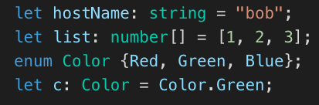

Types
Typescript provides the following basic types – Boolean, number, string, arrays [], object literals{}, undefined, null, enum, any and void
Typescript’s type inference let the language choose the types automatically based on the literal and context of usage. In the below example, type of x is inferred a number

Slide 11
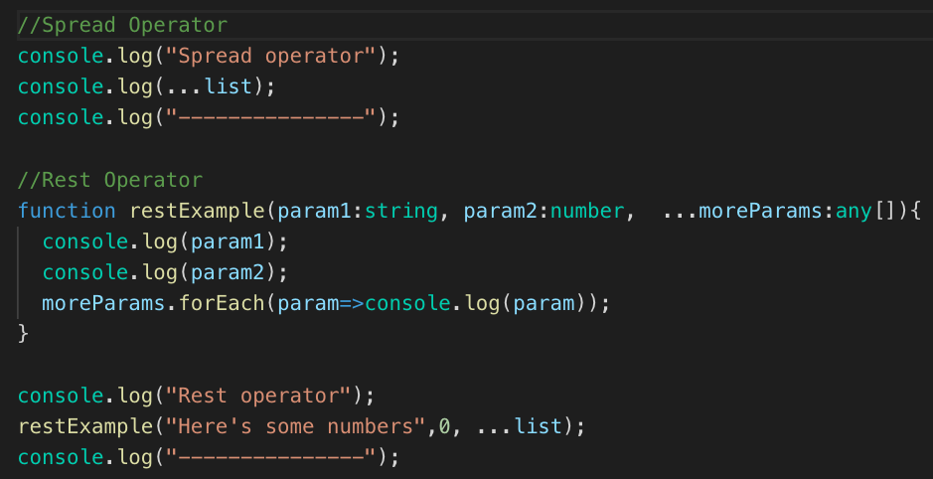
Types
Spread and Rest Operators
Rest operator
must be last
formal parameter

Slide 12
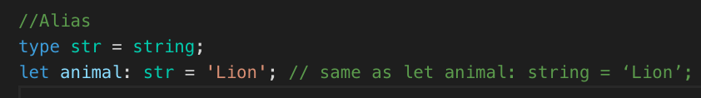
Types
Type keyword usage
Alias

Slide 13
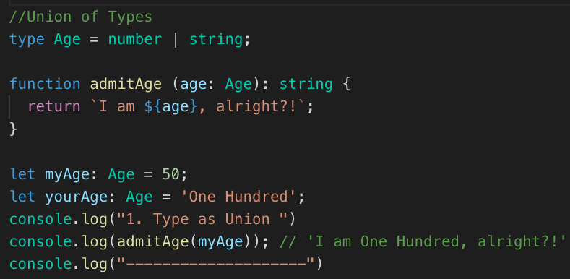
Types
Union of Types

Slide 14
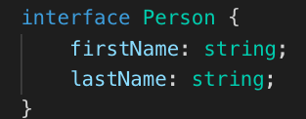
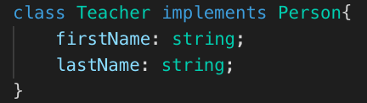
Classes & Interfaces
TypeScript interfaces define contracts of an object and its functions
TypeScript classes are types that could be instantiated

Slide 15
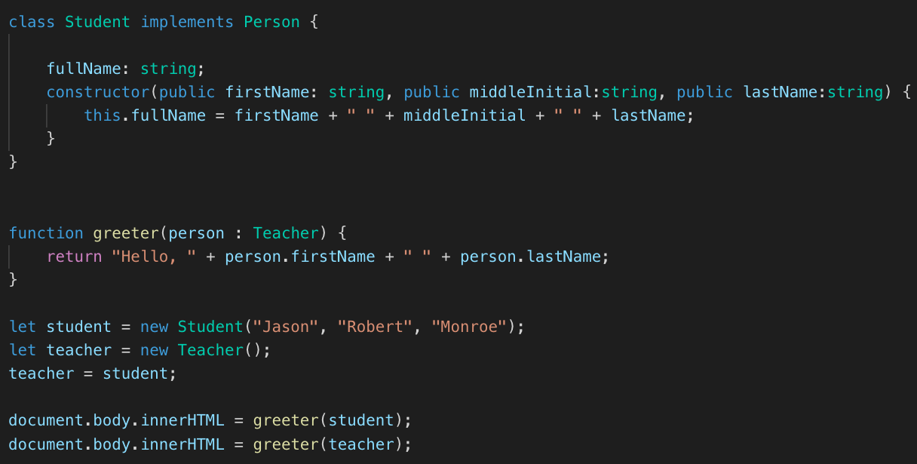
Shapes
Shapes: Any two JavaScript objects (despite from different classes) are considered equivalent, if they are composed of same type of attributes

Slide 16
Decorators
Decorators are auxiliary components that can be hosted by Classes, Methods, Properties or Parameters
These are specialized functions that execute in the context of the entity that they decorate – class / method etc.
Any function can be used as a decorator
See https://www.typescriptlang.org/docs/handbook/decorators.html for more info

Slide 17
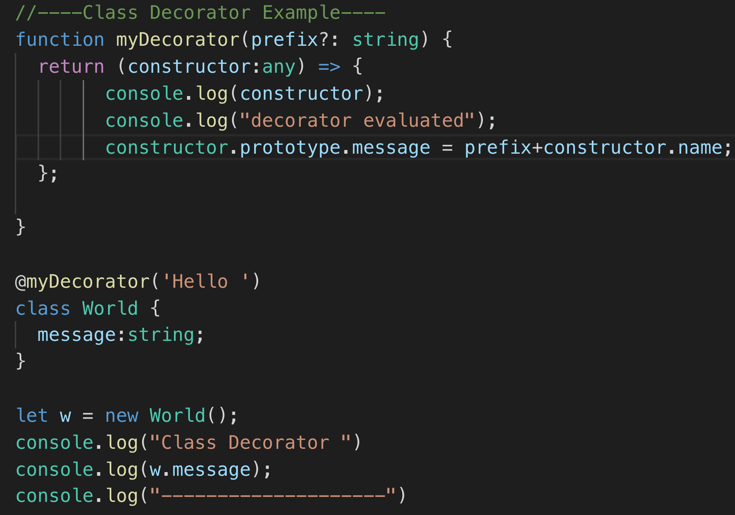
Decorators
Class Decorator
The class decorator function is called with the following argument:
Either the constructor function of the class for a static member, or the prototype of the class for an instance member.
Decorator executed at time of class evaluation (not instantiation)

Slide 18
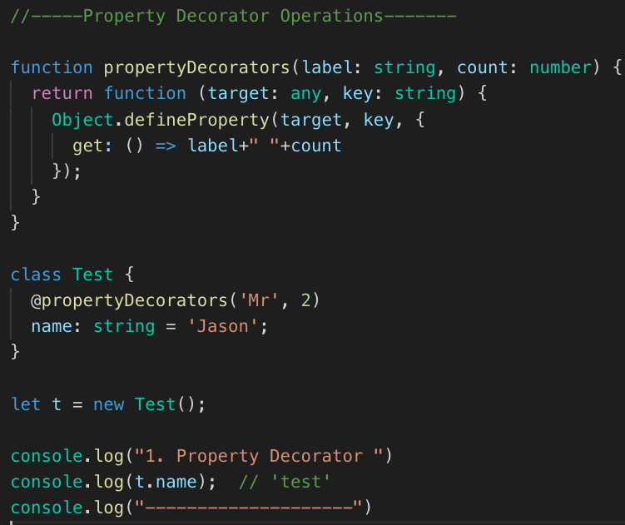
Decorators
Property Decorator
The property decorator function is called with the following arguments:
Either the constructor function of the class for a static member, or the prototype of the class for an instance member.
The name of the member (property).

Slide 19
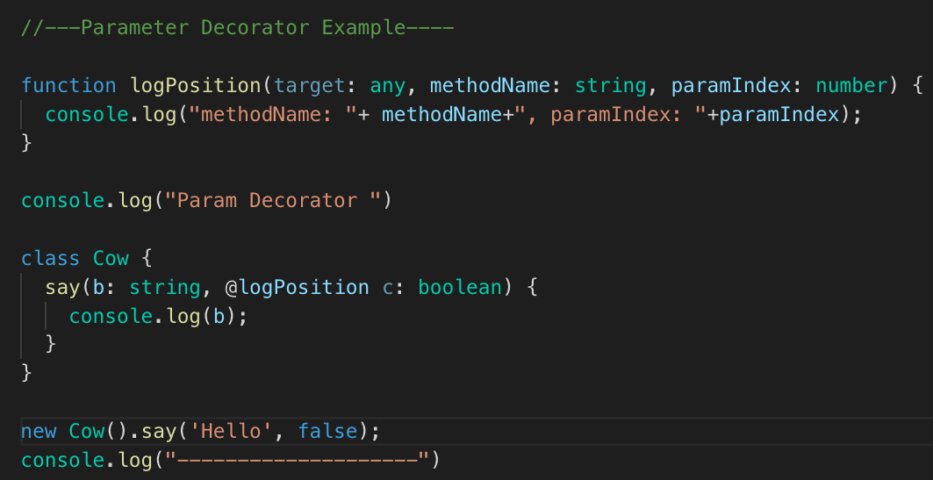
Decorators
Parameter Decorator
The parameter decorator function is called with the following arguments:
Either the constructor function of the class for a static member, or the prototype of the class for an instance member.
The name of the member (method).
The ordinal index of the parameter in the function's parameter list.

Slide 20
Data Binding

Slide 21
Data Binding
<Template>
{{interpolation}}
[property]=“binding”
(event)=“binding”
[(two-way)]=“binding”
@Component

Slide 22
Data Binding
Data binding signifies how and what kind of data is bound between a component and its template.
Interpolation – binds component properties in output template. It uses {{}}.
Property Binding – flows data from the component to the element. Uses [].
Event Binding – flows data from an element to the component. Uses ().
Two-Way Binding – is a combination of the Event and Property Bindings. Used along with the ngModel object. *Must Import FormsModule
<span>{{interpolatedValue}}<span>
<span [style.color]="componentStyle">Some colored text!</span>
<button (click)="alertTheWorld()">Click me!</button>
<input md-input [(ngModel)]="dynamicValue"
placeholder="Watch the text update!" type="text">
<br>
<span>{{dynamicValue}}</span>

Slide 23
Two-Way Binding
Two-way data binding combines the input and output binding into a single notation using the ngModel directive.
The following statement:
is the same as:
<input [(ngModel)]="name">
<input [ngModel]="name" (ngModelChange)="name=$event">

Slide 24



Practice – HelloAngular
Property Binding Practice:
Add [style.color]=‘myColor’ property binding to the h2 element in app.component.html
Add myColor property to app.component.ts. Make it a string type and assign it a literal that is your favorite color. Verify that the h2 color changed in your app (it should be served to observe this )
Event Binding Practice:
Add a button with a click event that calls a function called “changeColor()”
Define the function as shown below in app.component.ts. Verify that clicking the button changes the color.
Notes:
Instructions to Trainer:
Instructions to Facilitator:

Slide 25
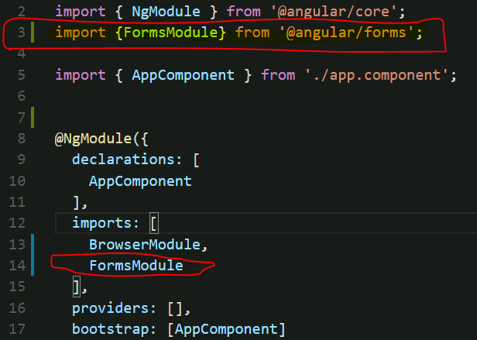
Practice – HelloAngular
Two-Way Binding Practice:
Add an input element to app.component.html with a binding to ‘myColor’
In order for Two-Way binding to work, FormsModule must be imported in app.module.ts
Type color names into the new textbox and verify that the color of the h2 element changes
Notes:
Instructions to Trainer:
Instructions to Facilitator:

Slide 26


Questions

Slide 27
You have successfully completed
Angular Basic Concepts, Binding

Slide 28
Thank You

